Slide 1
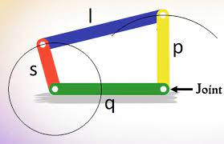
Mechanism Sessional (ME29002)
GROUP PROJECT
Group members:
Kadagala Raja - 20ME10050
Tondapu Satya Varun - 20ME10088
Lambu Kushi Reddy - 20ME30032

Slide 2
Question
1. Synthesize and make a simulator for the wind screen wiper mechanism shown in Tutorial sheet 2, Q6 with no quick-return effect. In the simulation, mark the area wiped. Add any new idea you might have (e.g., adjustment provision to change/increase the wiped region, determination of wiping speed and acceleration (or their variation) for a given motor speed (constant), torque requirement on motor (neglecting dynamics) etc.).

Slide 3
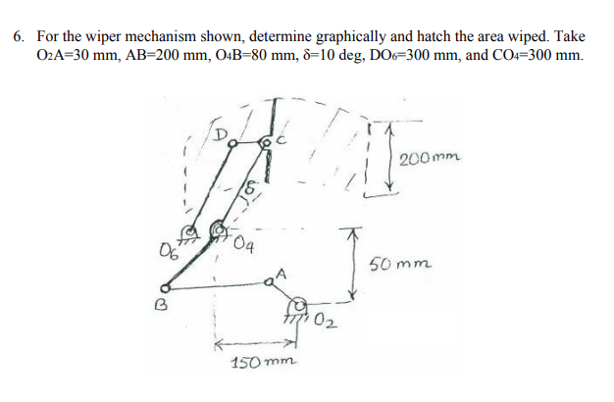

Slide 4
80
P
Q
C
200
R
S
O₆
O₄
X′
50
O₂
X
B
A
150

Slide 5
80
P
Q
C
200
R
S
O₆
K(i)
O₄
X′
50
10⁰
O₂
X
B
T(i)
A
150

Slide 6
80
P
Q
C
200
R
S
O₆
K(i)
O₄
X′
50
10⁰
Tan¯¹(1/3)
O₂
X
B
T(i)
A
150

Slide 7
C
e
10⁰
O₄
a
d
B
O₂
c
b
A

Slide 8
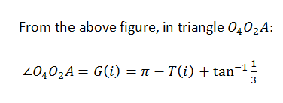
O₄
Tan¯¹(1/3)
O₂
B
T(i)
A

Slide 9
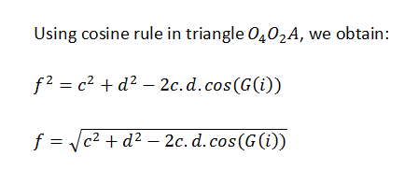
O₄
a
d
f
O₂
B
G(i)
c
b
A

Slide 10
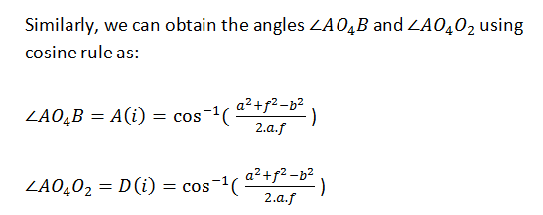
O₄
A(i)
a
D(i)
d
f
O₂
B
G(i)
c
b
A

Slide 11
e
10⁰
E(i)
O₄
X′
Tan¯¹(1/3)
A(i)
D(i)
a
d
O₂
B
X
c
b
A
A(i) + D(i) + Tan¯¹(1/3) + E(i) = Π
E(i) = Π – (A(i) + D(i) + Tan¯¹(1/3) )

Slide 12
C
O₆
K(i)
O₄
X′
10⁰
Tan¯¹(1/3)
O₂
X
B
T(i)
A
K(i) = E(i) + 10⁰

